Slide 1



CME 4112 IMAGE PROCESSING
MOTION PREDICTION WITH KALMAN FILTER
2019510038 SIMAY GÖÇEN
2024,İzmir

Slide 2

What is Kalman Filter
How It Works?
Environment
OUTLINE
Implementation
Tests and Results
Conclusion
References

Slide 3
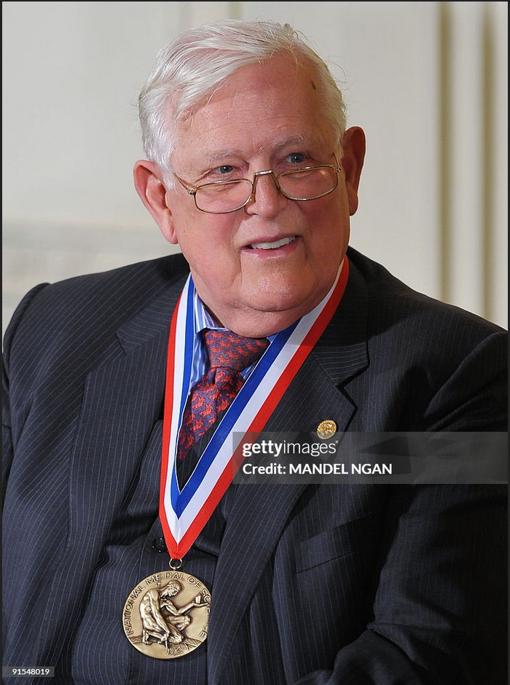
KALMAN FILTER
The Kalman filter is a balancing and estimation algorithm developed by Rudolf Emil Kálmán in the early 1960s.
It was originally designed for use in positioning and navigating spacecraft.
Kalman filter is a mathematical method used to predict future situations from data containing uncertainty.

Slide 4





HOW IT WORKS?
Predict
Update
Repeat the Process

Slide 5


ENVIRONMENT

Slide 6
IMPLEMENTATION
kalmanfilter.py
orange_detector.py
orange_prediction.py

Slide 7
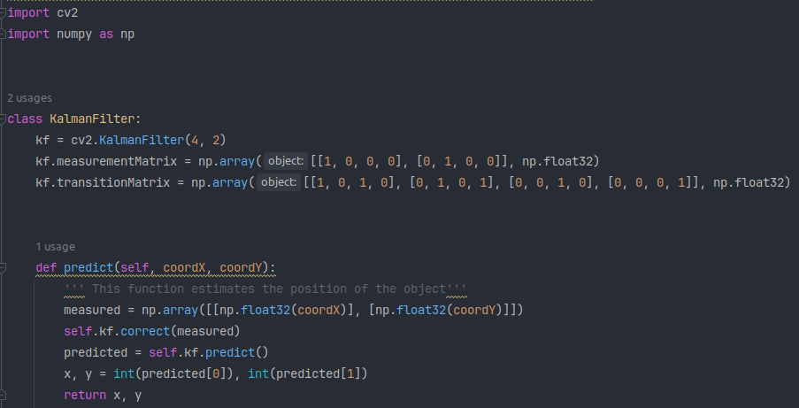
KALMANFILTER.PY

Slide 8
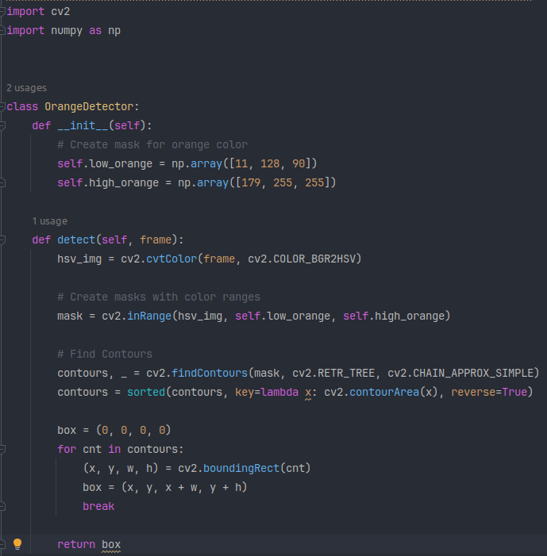
ORANGE_DETECTOR.PY

Slide 9
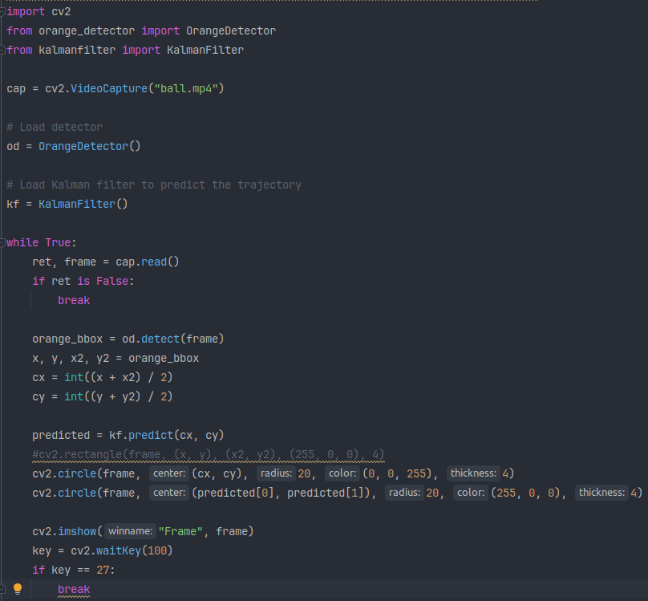
ORANGE_PREDICTION.PY

Slide 10
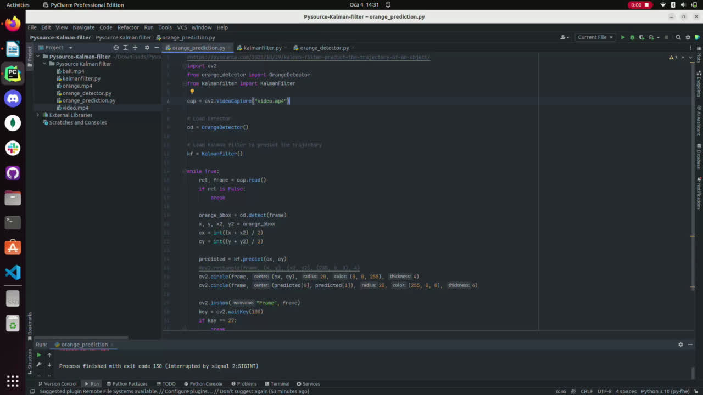
OUTPUTS

Slide 11
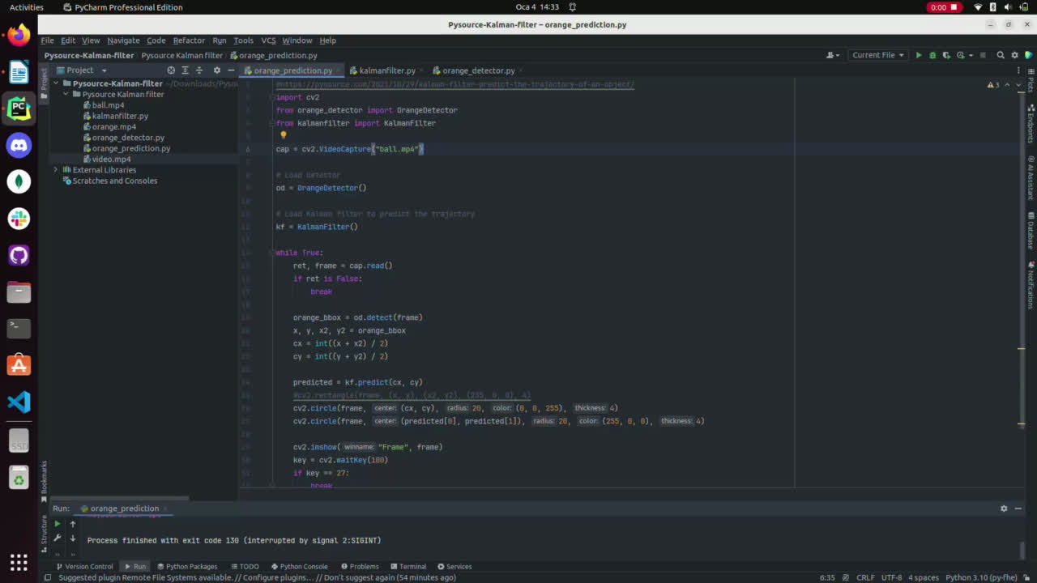
OUTPUTS

Slide 12
CONCLUSION
AUTONOMOUS VEHICLES AND FLYING UNMANNED VEHICLES (UAVS)
MEDICAL APPLICATIONS
WEATHER FORECAST
SMART CITIES AND INTERNET OF THINGS (IOT)
FINANCIAL MARKETS
:

Slide 13
REFERENCES
HTTPS://GITHUB.COM/SRIRAMEMAROSE/MOTION-PREDICTION-WITH-KALMAN-FILTERH TEXT
HTTPS://GITHUB.COM/ALPSARK/ROS-KALMAN-FILTER
HTTPS://GITHUB.COM/ZHOUJIAYI1017/KALMAN_FILTER
HTTPS://GITHUB.COM/BALZER82/KALMAN
HTTPS://GITHUB.COM/TKJELECTRONICS/KALMANFILTER
HTTPS://WWW.YOUTUBE.COM/WATCH?V=3IQRHBXBVRE
HTTPS://EN.WIKIPEDIA.ORG/WIKI/KALMAN_FILTER
HTTPS://WWW.KALMANFILTER.NET/DEFAULT.ASPX

Slide 14
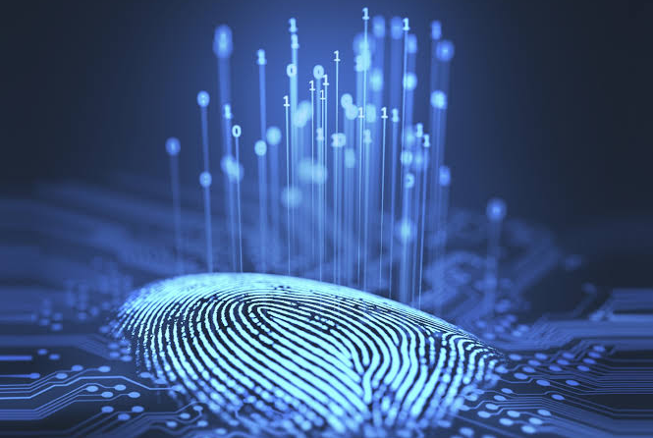
THANK YOU!

